Slide 1

IST769 Advanced Big Data Management Final Project
Madhumitha Saravanan
Sindhuja Maheswaran

Slide 2

Couchbase is a distributed, multi-model NoSQL database that is designed to support modern, data-intensive applications across various industries and use cases.

Slide 3

DATA ORGANIZATION
Couchbase uses a flexible multi-level data organization model
Buckets: Top-level containers that can hold multiple datasets.
Scopes: Logical groupings of collections, similar to database schemas.
Collections: Categorized groups of JSON documents, analogous to tables.
Documents: Individual JSON documents stored within collections.

Slide 4
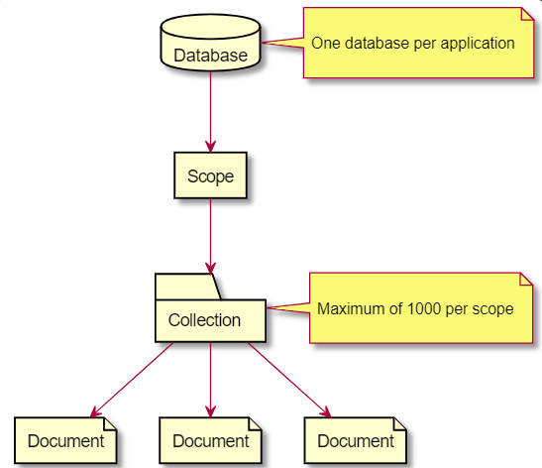
Conceptual Data Model
The conceptual model of Couchbase revolves around key concepts such as buckets, documents, keys, and views
A bucket is a logical container for storing data and it is schema-less.
Each Bucket can have one active copy and zero or more standby replicas hosted on different machines, providing data redundancy and fault tolerance
A document is the basic unit of data storage in Couchbase.

Slide 5
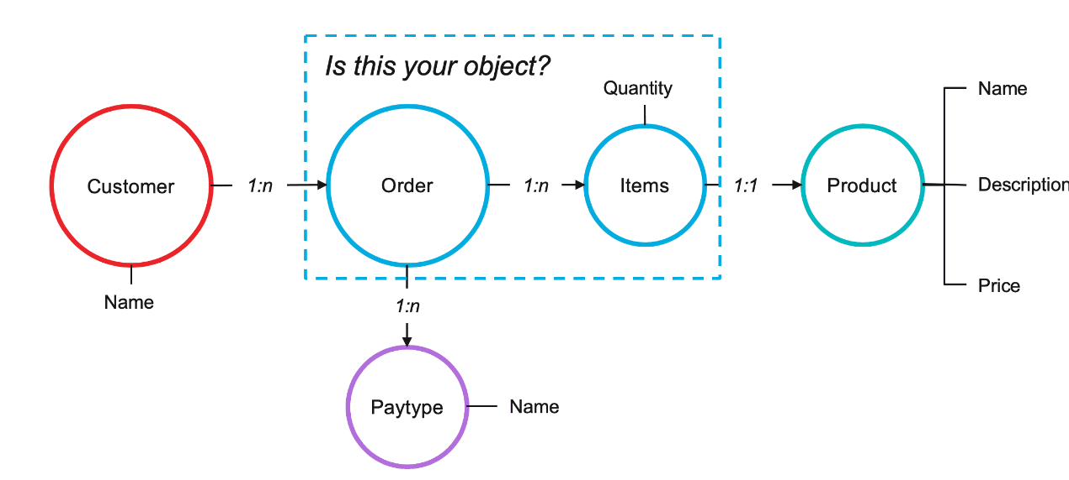
Logical Model
In the logical data model, entities are mapped to individual JSON documents, and relationships between entities are represented through references (foreign keys) rather than joins.
Instead of relying on joins like in relational databases, related entities may be nested within each other or referenced directly.
References (Foreign Keys): Relationships between entities can be represented using references, where one entity includes a reference (typically an ID) to another entity.
For example, a document representing an order might include references to the user who placed the order.

Slide 6
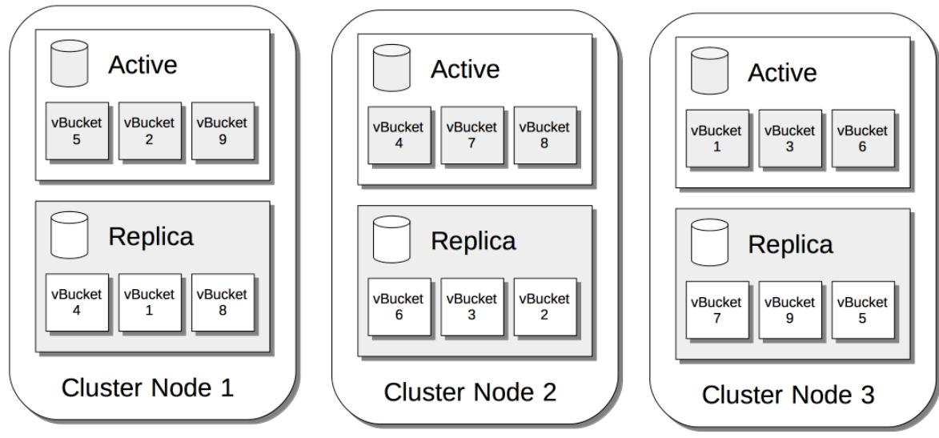
Couchbase Cluster
Cluster Nodes:
Couchbase operates as a cluster of nodes, where each node can be a physical or virtual machine.
Nodes within a cluster communicate with each other to distribute data, share workload, and ensure high availability.

Slide 7

Why CouchBase is ACID ?
Atomicity- Updates multiple documents with all-or-nothing guarantee.
Consistency- Automatically maintained consistency for replicas, indexes, and XDCR
Isolation- Read committed isolation for concurrent readers.
Durability- Data protection under failures with tunable durability levels.

Slide 8
Multi-Model Support
Key-Value: Direct document access via keys for low-latency reads and writes.
JSON Documents: Flexible schema-less document storage and retrieval.
SQL-based Querying: Declarative querying of JSON data using N1QL/SQL++.
Full-Text Search: Powerful text search capabilities with relevance scoring.
Analytics: Running analytical queries on operational data without ETL.

Slide 9
STORAGE MODEL
Couchbase's storage engine, called Couchstore, was initially designed for a memory-oriented database to provide high-performance, low-latency access to data primarily from memory
Couchbase usage grew, customers wanted to store larger datasets that could not fit entirely in memory. This led Couchbase to develop a new storage engine called Magma, which is designed to handle large datasets that primarily reside on disk
Magma is optimized for high performance with minimal memory requirements, allowing Couchbase to store large amounts of data (e.g. 1TB) with as little as 1% of the data size in memory.

Slide 10
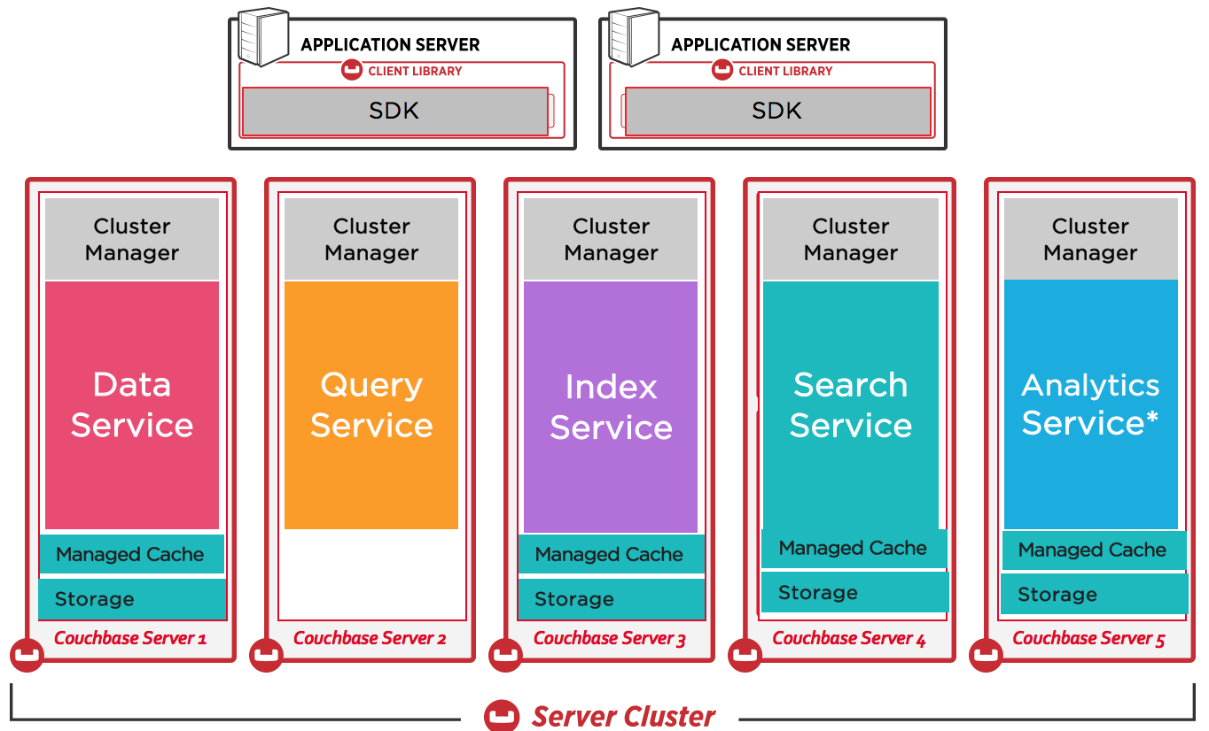
ARCHITECTURE

Slide 11
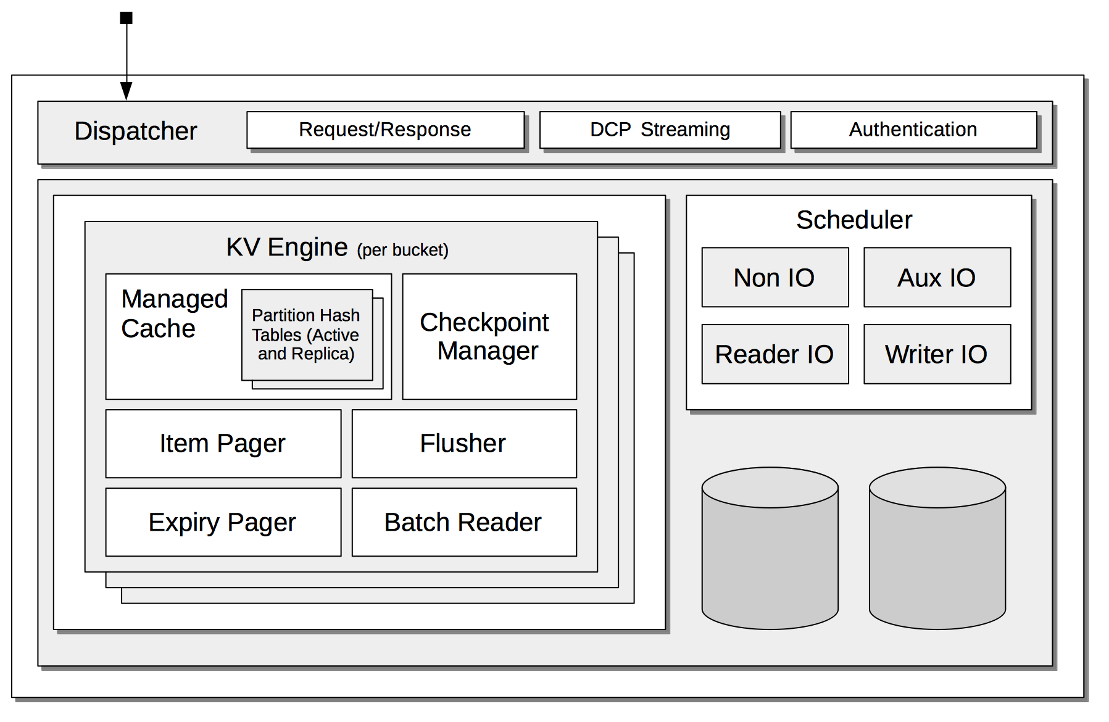
DATA SERVICE:
It handles document storage, retrieval, and replication across nodes. It supports different storage engines like Couch store (in-memory) and Magma (disk-optimized).

Slide 12
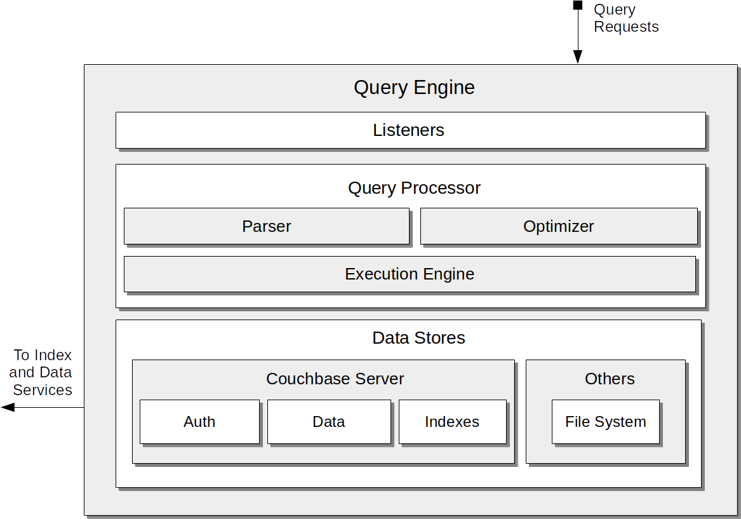
QUERY SERVICE:
It provides a SQL-based query language (N1QL/SQL++) for querying JSON data using declarative queries.

Slide 13
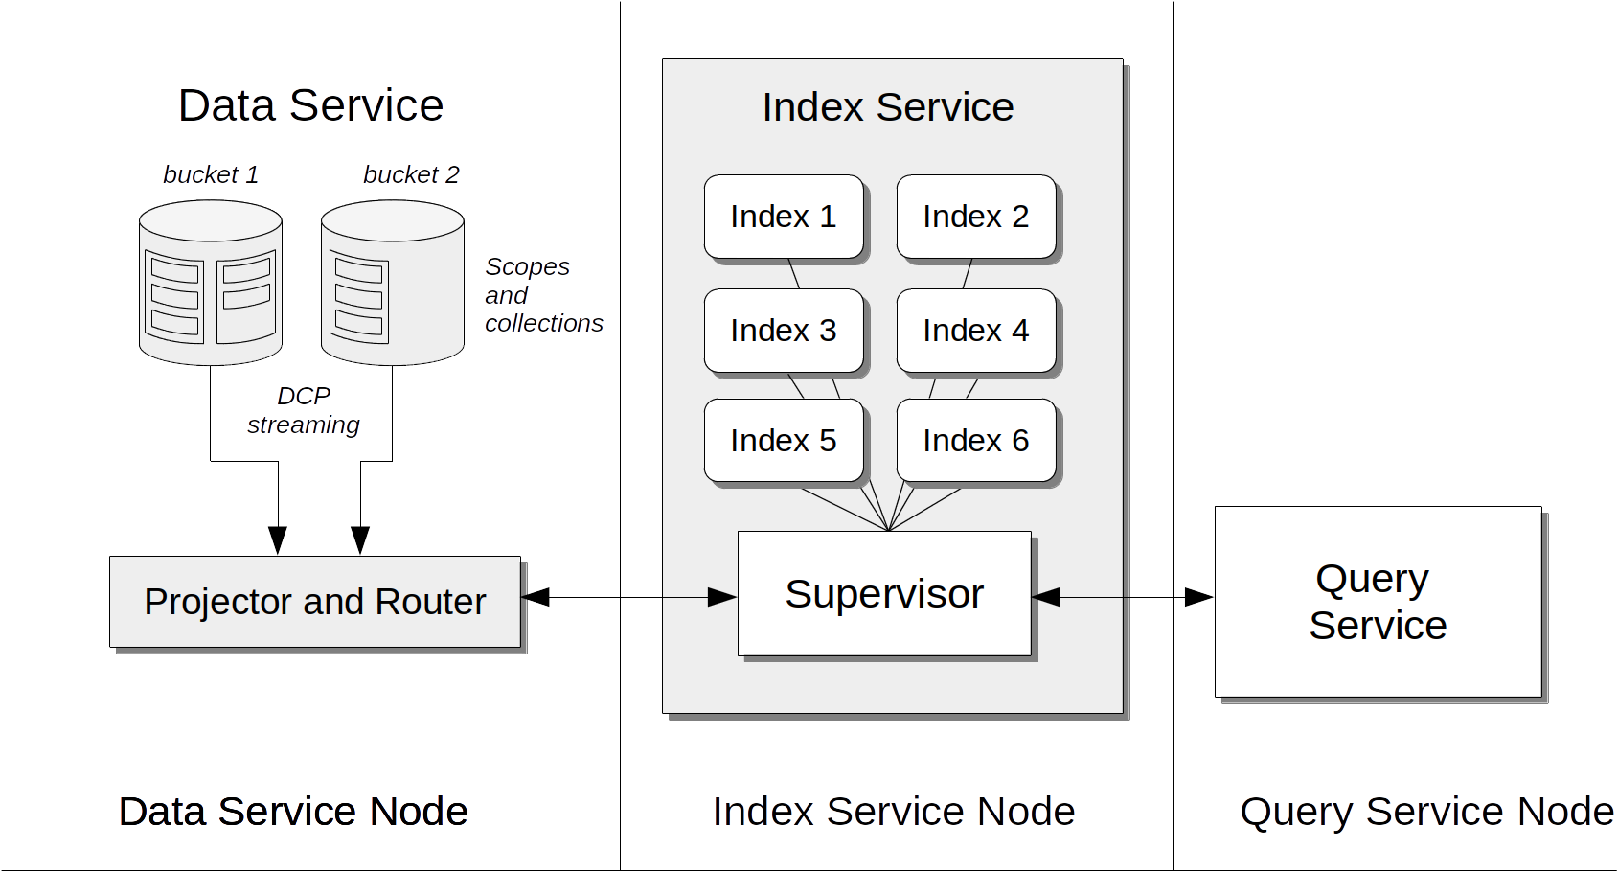
INDEX SERVICE:
It manages global secondary indexes for efficient querying and full-text search capabilities

Slide 14

ANALYTICS SERVICE:
It enables running analytical queries directly on operational data without impacting transactional workloads

Slide 15

SEARCH SERVICE
It offers full-text search capabilities with relevance ranking and support for various text analyzers.

Slide 16
Use Cases and Applications
Web and Mobile Applications
Edge Computing and IoT
AI and Machine Learning
Digital Banking and Financial Services
E-commerce and Retail
Travel and Hospitality

Slide 17
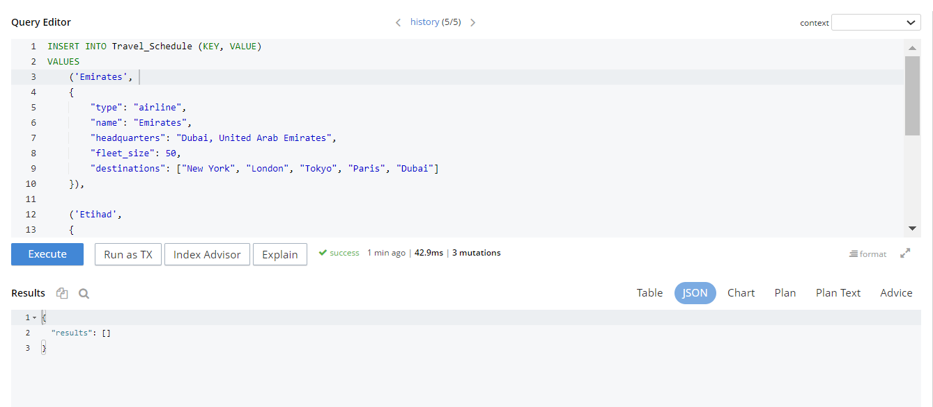
CRUD Operation CREATE/ INSERT:

Slide 18
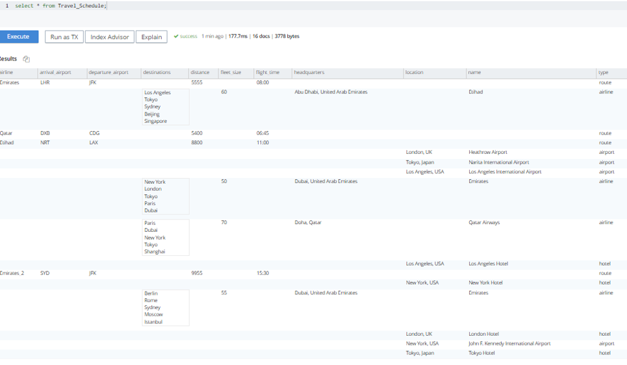
READ:

Slide 19
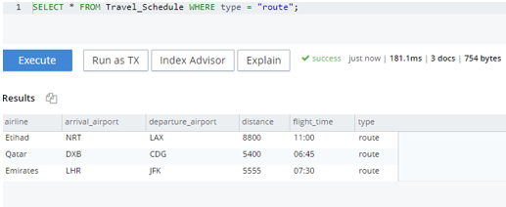
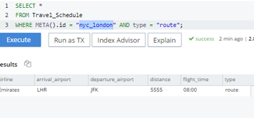
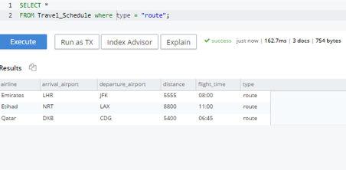
UPDATE

Slide 20
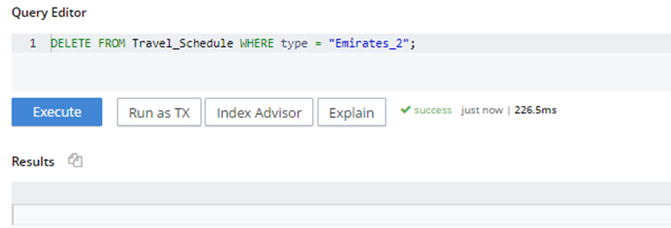
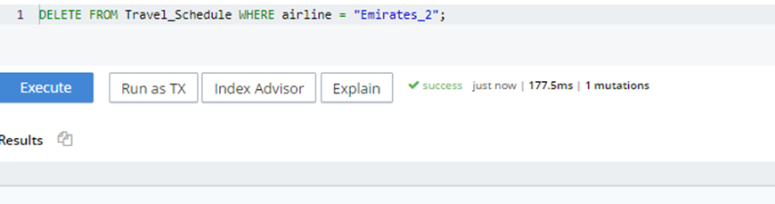
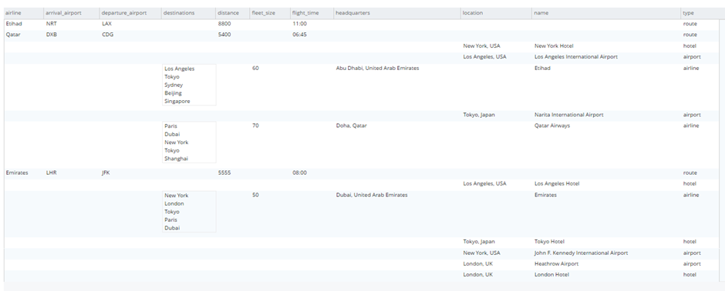
DELETE

Slide 21

SUMMARY:
Couchbase's flexible, scalable, and high-performance NoSQL database capabilities make it a suitable choice for a variety of use cases across different industries, from personalization and user management to real-time analytics and content delivery.

Slide 22
LESSONS LEARNT:
How to run Couchbase using Docker
How to create Bucket and Keyspace in Couchbase
How to use Query service in Couchbase
How to perform basic crud operations using N1QL Query in Couchbase

Slide 23
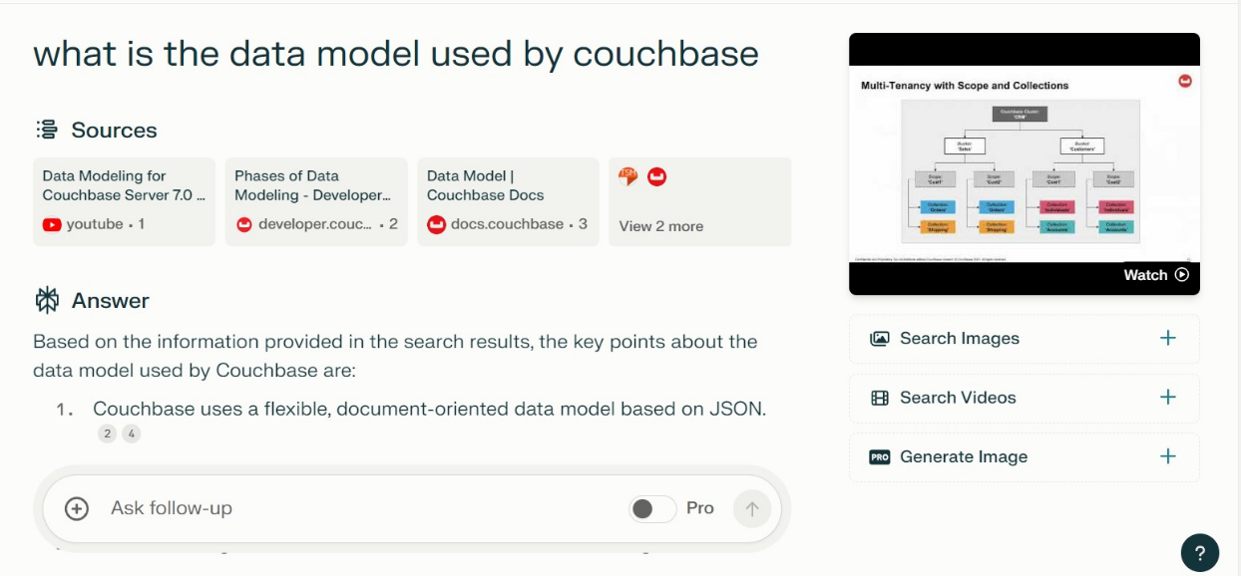
PERPLEXITY AI PROMPT

Slide 24
REFERENCES
https://docs.couchbase.com/home/server.html
https://www.youtube.com/watch?v=9ir8-81vLY0
https://cloud.couchbase.com/playground/sqlPlusPlus/LEARN_QUERY_BASICS?oid=580a995c-7bab-47c1-8f88-dbd13c9f5559
https://docs.couchbase.com/cloud/get-started/run-first-queries.html
https://github.com/couchbase-examples/python-quickstart/
https://docs.couchbase.com/cloud/get-started/create-account.html
https://www.perplexity.ai/search/couch-base-applicattions-uoDxLhlASvG5f3hrMtZIBA

